Slide 1

ANDROID PIN CRACKING
Malaviya National Institute technology, Jaipur
Guided by:
Dr Vijay Laxmi
Presented by:
Nidheesh Panchal (2016UCP1008)
Siddhant Gupta (2016UCP1455)
Rahul Jangir (2016UCP1396)

Slide 2
Abstract
Numeric PINs of a smartphone to be predicted by an attacker using motion data.
Zero-permission motion sensors play crucial role in exploiting this vulnerability.
Website opened in a browser or an application in background can collect data.
The pattern of each key press is observed and a suitable model is trained to identify individual digits.

Slide 3
Introduction
Two major smartphone operating systems are Android and iOS.
Market share of Android and iOS is 73% and 27%, respectively.
Targeting Android devices means covering larger portion of all smartphones.
When screen is touched on specific portions, a unique spike is created by the motion
Extracting such information and using it to know which part of the screen was touched.
Using it as a dataset to feed into a supervised multiclass machine learning (ML) model.
Tells which part of the screen was touched where that particular number key is present when the user is entering the PIN.

Slide 4
Types of Android Sensors
Motion Sensors
Accelerometer Sensor
Gyroscope Sensor
Gravity Sensor
Environmental Sensors
Position Sensors
These sensors are used for various activities like auto screen rotation, step counter etc.
These pool of sensors may unintentionally leak sensitive information as it requires no permission from user.

Slide 5
Basic Theory
User enters PIN on numerical keypad where each possible number is in the range of (0-9).
While entering the numbers, user moves fingers to reach the number.
Smartphone will tilt, rotate or move.
These movements are minute but could be easily captured by motion sensors.
Type of sensors that captures such motion are Motion Sensors (Accelerometer, Gyroscope and Gravity).

Slide 6
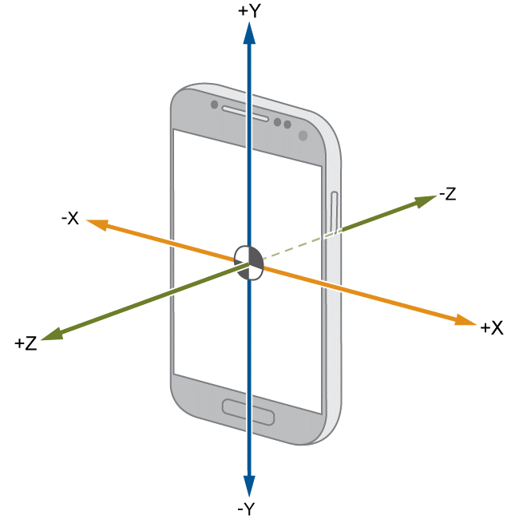
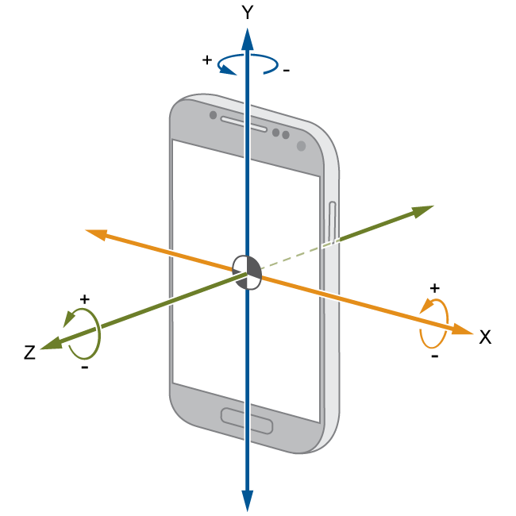
Motion Sensors
Accelerometer
Gyroscope

Slide 7
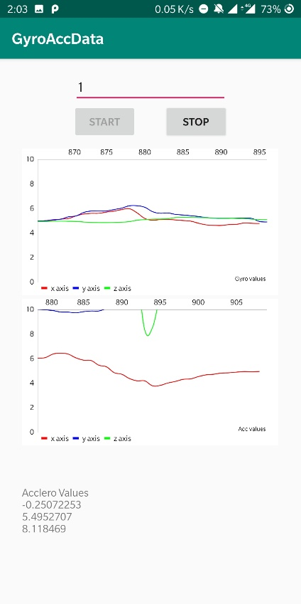
Behaviour of Sensors
Sudden spike is seen in the graph when the screen is touched.
The top graph shows the gyroscope and bottom graph shows accelerometer sensor data plotted against time.
Red: x-coordinate
Blue: y-coordinate
Green: z-coordinate

Slide 8
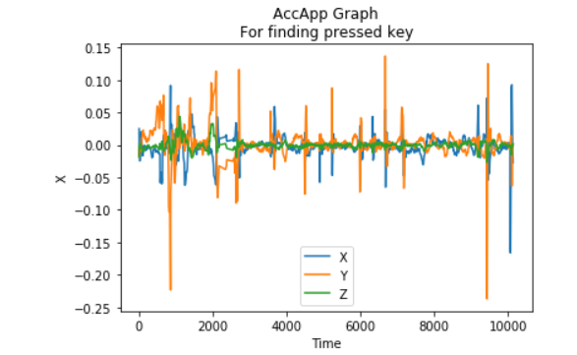
Behaviour of Sensors
We can see different patterns when different keys are pressed.

Slide 9
Proposed Method
We propose a method to identify individual digits of a PIN.
Using an Android application for data collection.
Processing raw data for input to Machine Learning model to predict individual digits.
Building background service for actual exploitation.

Slide 10
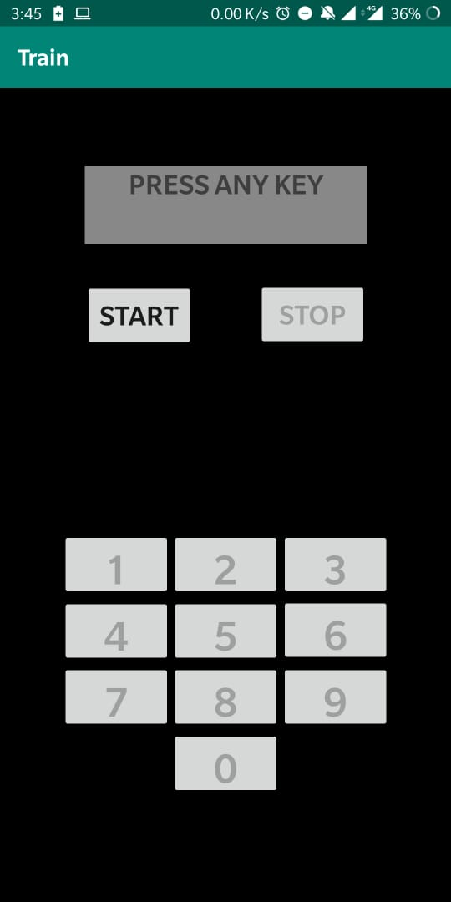
Application for collection
An Android application was built to collect motion sensor data for model training.
Application named as Train.
Android application was chosen over web browser because sampling rates available in browsers are much lower than those in mobile application.
Buttons arranged at similar position as a phone PIN keyboard.

Slide 11
Data collection
A user is made to either sit or stand and hold the phone in right hand in one identical position and use only right thumb (in-hand data).
Putting the phone on a flat stationary surface (on-table data).
A single file is created for each key press.
Random keys are pressed.
The app collects 4 types of sensor data
Accelerometer with gravity
Accelerometer without gravity
Gyroscope
Gravity

Slide 12
Preprocessing
The raw data collected from the application contains multiple rows of X, Y, Z coordinate values and time.
The timestamp of onKeyDown and onKeyUp actions and the number key that was pressed was saved in file name.
Three ways of data processing were used and accuracies obtained from different classification models were compared. (window of 25 and 30 values).
Windowing
Three values
Three values from uniform data.

Slide 13
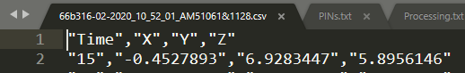

Preprocessing
Raw data
Processed data

Slide 14
Classification models
Following models were used for classification.
Random Forest
Decision Tree
Logistic Regression
Naïve Bayes
KNN
SVM
Multioutput
Taking all types of pre-processed dataset and taking that as input to all models running in same configuration for each (to do justice to the comparison).

Slide 15
Experimental Results
It was observed that motion detected by the gravity sensor did not show remarkable changes in sensor data values, hence did not contribute to give accurate prediction. (16%).
The following table shows maximum accuracy among all 3 types of processing methods. On-table data = 400 key press. In-hand data = 400 key press.
The processed input file are from accelerometer and gyroscope. (individually)
Processed file is split in 80:20 for train and test data.

Slide 16
Multioutput Classification Results
In multioutput classification, 4 outputs are obtained and the accuracy is calculated as:
number of times the actual key pressed label is present in this list of 4 outputs/size of test data
“List of 4” column in the following table, displays this accuracy measurement and “First 2” column displays accuracy of the actual key press present in the first 2 position from the list of 4.
The following table shows maximum accuracy among all 3 types of processing methods.
 | Multioutput
Type of data | Acc (%) |  | Gyro (%)
 | First 2 | List of 4 | First 2 | List of 4
On-table | 41 | 62 | 44 | 61
In-hand | 49.64 | 72.34 | 59.57 | 73.75
Hybrid | 43.56 | 61.82 | 51.45 | 67.63

Slide 17
Method 2
Learning from results from the previous method.
New data collection, processing and classification models used.

Slide 18
Data collection
Collected 2700 files from the user in similar method in such a way that each digit (0-9) appear after each other.
These allowed to record motion that mimics the actual motion moving from one key to other.

Slide 19
Preprocessing
Observing that the window of key press can be maximum up to 100ms, we extend the window size to accommodate all relevant data of the path.
Using individually all other 3 types of sensor data and combining each accelerometer type with gyroscope.
Processing methods are as follows:
Window of size 200 and 400
Uniform time then take window (200, 400)
Uniform time, remove initial values and take window (200, 400)
The window of onKeyUp and onKeyDown is positioned in 2 ways:
Center
At the end

Slide 20
Classification models
Logistic Regression
SVM
Multi-Layer Perceptron
Deep learning

Slide 21
Experimental Results
The following table shows maximum accuracy among all types of processing methods.
It was observed that combining the Accelerometer and Gyroscope sensor data gave better accuracies compared to individual processed data.
Model | Type of processing |  |  | Accuracy (%)
 | Acc w/o grav (size) | Gyro (size) | Type
Logistic Regression | 200 | 200 | Window | 64.29
SVM | 400 | 400 | Uniform | 58.55
MLP | 200 | 400 | Window | 66.38
Deep learning model | 200 | 200 | Window | 64.99
Processed file is split in 75:25 for train and test data.

Slide 22
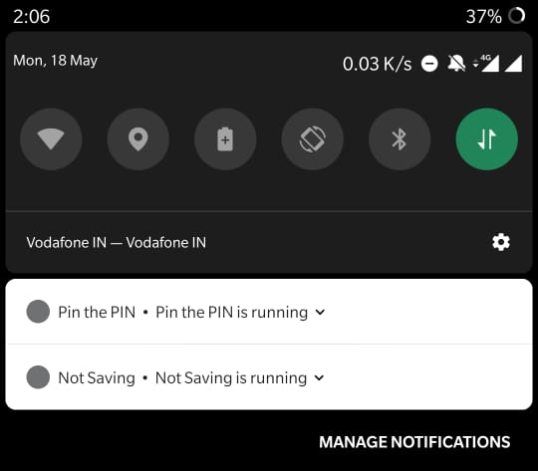
Exploitation
“Pin the PIN” app keeps a service running in the background that records sensor data.
Records when the phone is locked and the screen is on.
Saves the file when the phone is unlocked.
Uploads the file to Google Firebase storage.
Service running in background

Slide 23
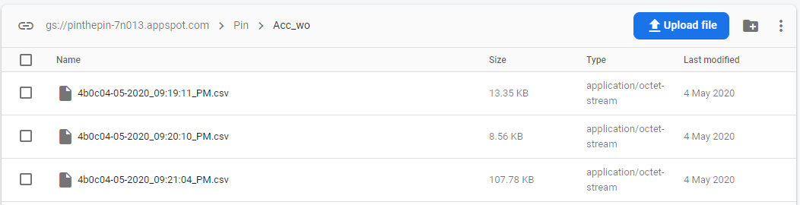
Exploitation
Google firebase storage

Slide 24
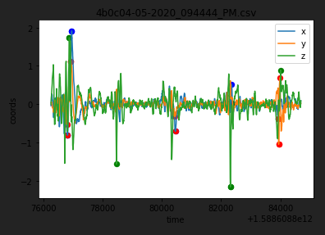
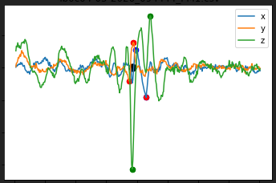
Exploitation
Graph of one unlock with 4-digit PIN
Getting timestamp from the spikes
(black dot shows timestamp)
Same processing method is used as the model which will predict the key pressed

Slide 25
Experimental Results
Processing file: Accelerometer without gravity and Gyroscope sensor data with 200 window size of each and combined in a row to form feature vectors
Model | 1 digit |  | 2 digits |  | 3 digits |  | 4 digits |  | Accuracies
 | G1 | G2 | G1 | G2 | G1 | G2 | G1 | G2 | G1 | G2
Logistic | 20 | 18 | 15 | 17 | 3 | 8 | 0 | 2 | 29.5 | 42
SVM | 21 | 19 | 11 | 16 | 1 | 9 | 0 | 0 | 22 | 39
MLP | 24 | 18 | 11 | 21 | 1 | 6 | 0 | 1 | 24.5 | 41
Deep Learning | 11 | 23 | 2 | 4 | 0 | 3 | 0 | 0 | 7.5 | 20
(G1 → Guess 1) (G2 → Guess 2)

Slide 26
Experimental Results
Model | 1 digit |  | 2 digits |  | 3 digits |  | 4 digits |  | Accuracies
 | G1 | G2 | G1 | G2 | G1 | G2 | G1 | G2 | G1 | G2
Logistic | 26 | 12 | 13 | 29 | 1 | 6 | 1 | 1 | 29.5 | 46
SVM | 19 | 17 | 9 | 16 | 7 | 7 | 0 | 4 | 29 | 43
MLP | 19 | 19 | 13 | 20 | 2 | 8 | 0 | 0 | 25.5 | 41.5
Deep Learning | 20 | 21 | 3 | 8 | 0 | 4 | 0 | 0 | 13 | 24.5
(G1 → Guess 1) (G2 → Guess 2)
Extending the dataset to 6450 files to train models

Slide 27
Conclusion
Exploring the sensors used on smartphones and exploiting the vulnerability, it is possible to develop a single-digit classification methodology to recover PIN from maliciously captured sensor data.
Using different types of preprocessing methods and different classification models to classify a single digit, the maximum accuracy achieved for on-hand data collection method is 42.5% with random forest, in-hand data collection method is 42.47% with SVM and merged data is 39.89% with KNN.
Using new data collection and processing methods where the combination of both sensor type, accelerometer without gravity and gyroscope with a window of 200 each gives a good accuracy for Logistic Regression (64.29%) and Deep learning model (64.99%).
Out of 50 4-digit PINs, we can predict at least one digit correct for 38 4-digit PINs.
The maximum prediction accuracy of 29.5% for 200 digits from Logistic regression model.
We can improve the model by adding more data.

Slide 28
Thank you

